Slide 1
What I have learned about fruit flies, proteins, and simulating cell dynamics, what I have been doing so far and what I expect to be doing for the coming year
Jakob Schauser

Slide 2
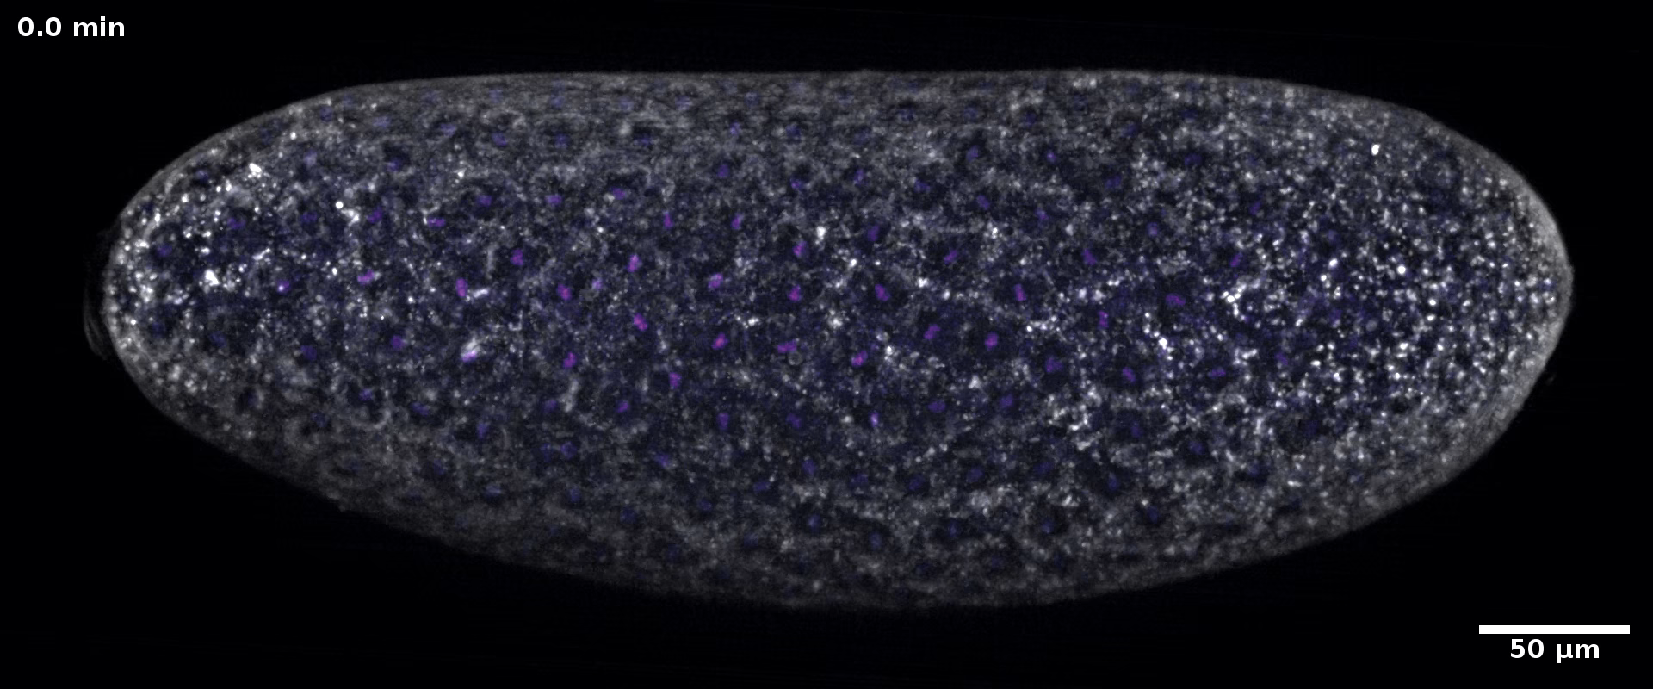
This is what a fruit fly does

Slide 4
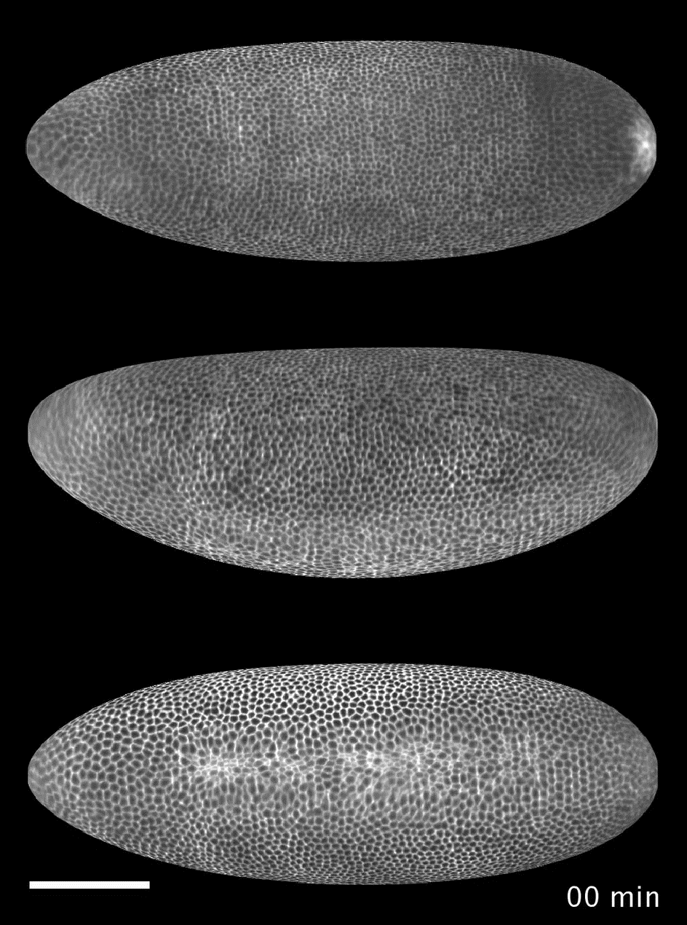
Lets see that again, from the bottom

Slide 5
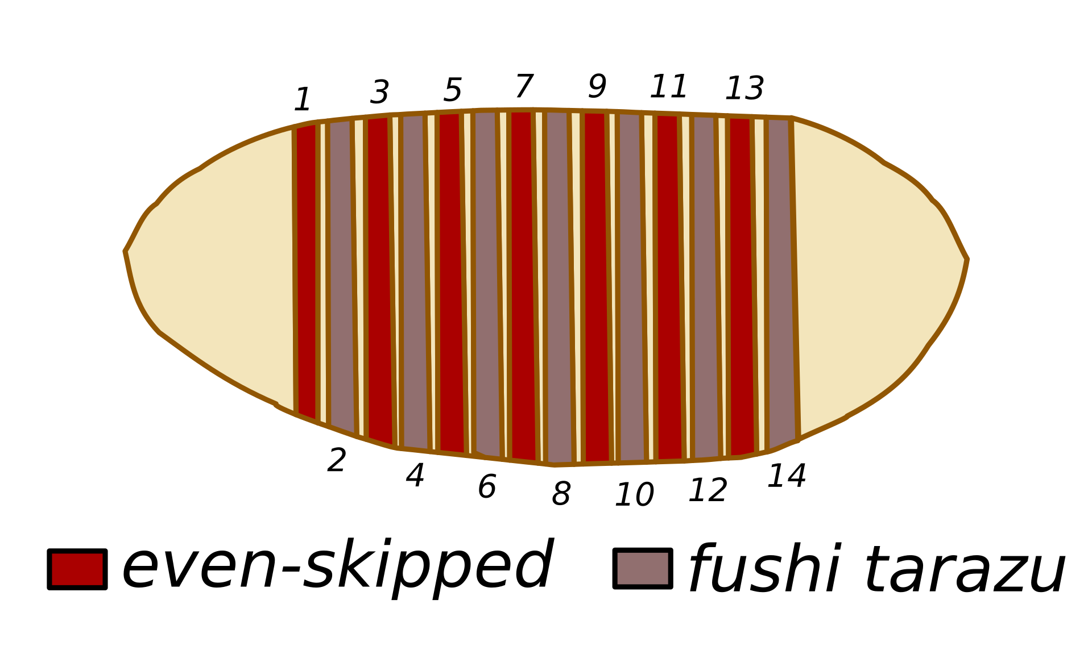
Pop quiz

Slide 6
Our model
These are its polarities
This is a cell
Through their interaction we define a potential
This is another cell

Slide 7
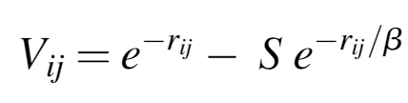
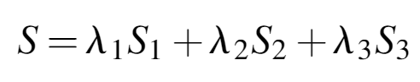
The potential

Slide 8
The potential
Is AB-polarity aligned and perpendicular to distance?

Slide 9
The potential
Is AB-polarity aligned and perpendicular to distance?

Slide 10
The potential
Is AB-polarity aligned and perpendicular to distance?
Are ABP and PCP aligned and at right angles?

Slide 11
The potential
Is AB-polarity aligned and perpendicular to distance?
Are ABP and PCP aligned and at right angles?

Slide 12
The potential
Is AB-polarity aligned and perpendicular to distance?
Is PCP aligned and perpendicular to distance?
Are ABP and PCP aligned and at right angles?

Slide 13
The potential
Is AB-polarity aligned and perpendicular to distance?
Is PCP aligned and perpendicular to distance?
Are ABP and PCP aligned and at right angles?

Slide 14
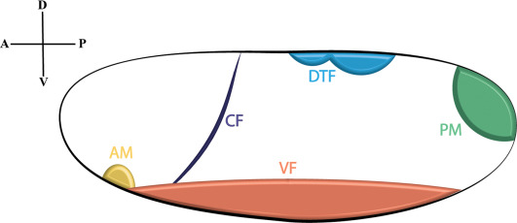
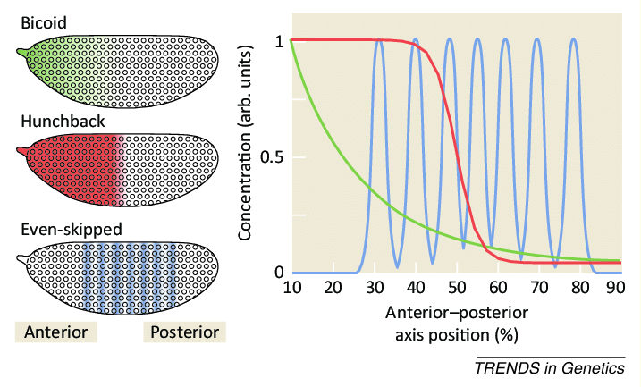
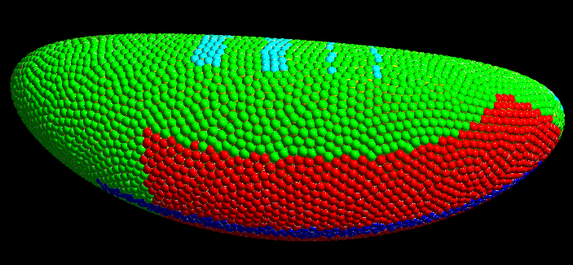
And finally: My work
Boundary- and initial condition
Implementation of genetic expression

Slide 15
Pop quiz
A) Hunchback
B) Spätzle
C) Mothers Against Decapentaplegic
D) Sonic Hedgehog
E) All of the above

Slide 16
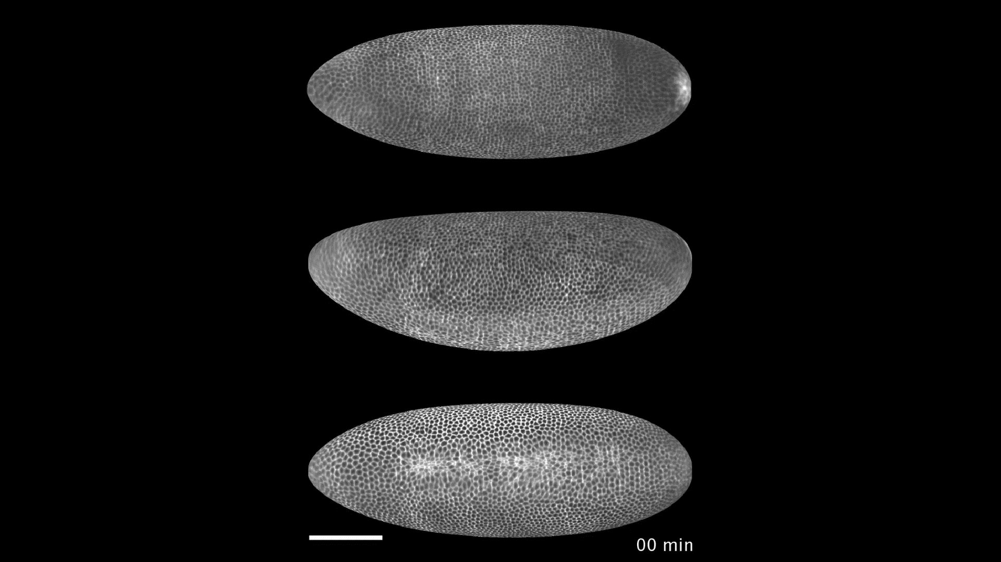
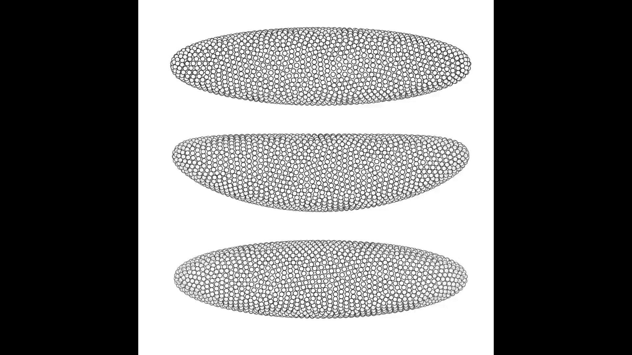
My results

Slide 17
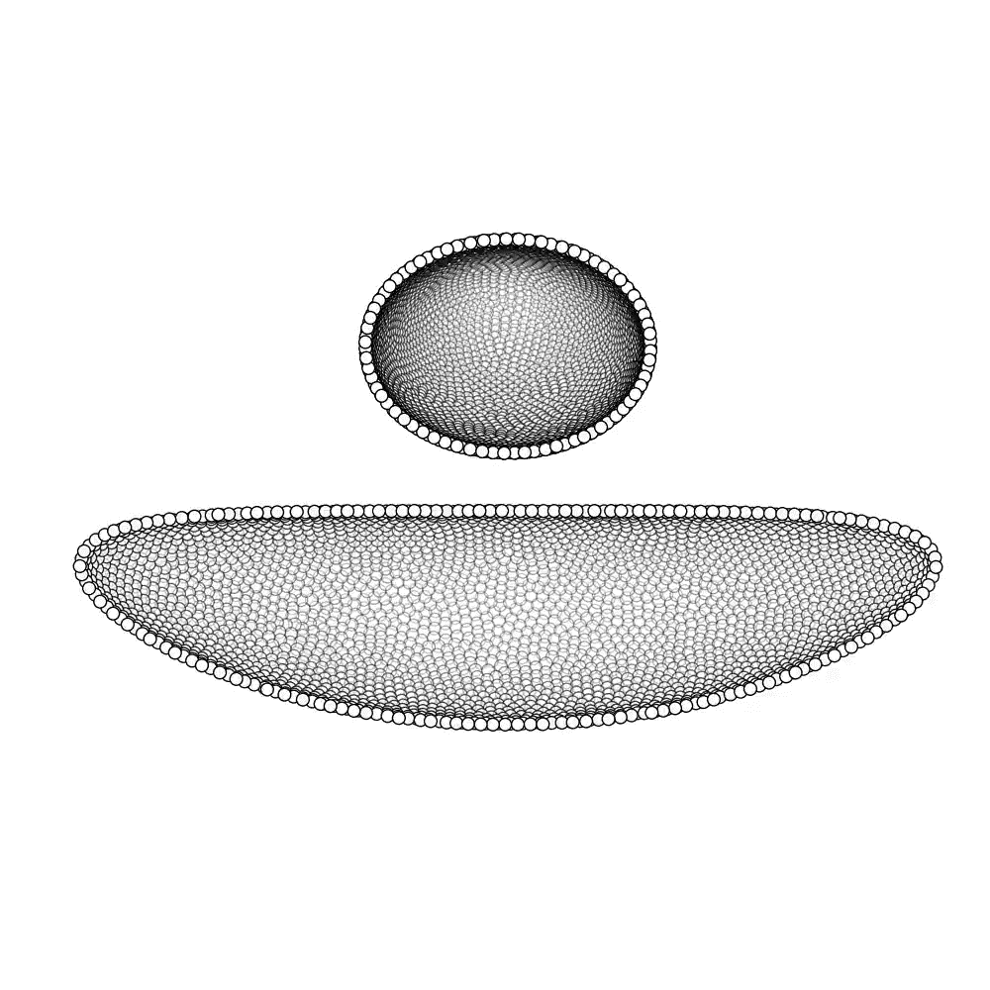
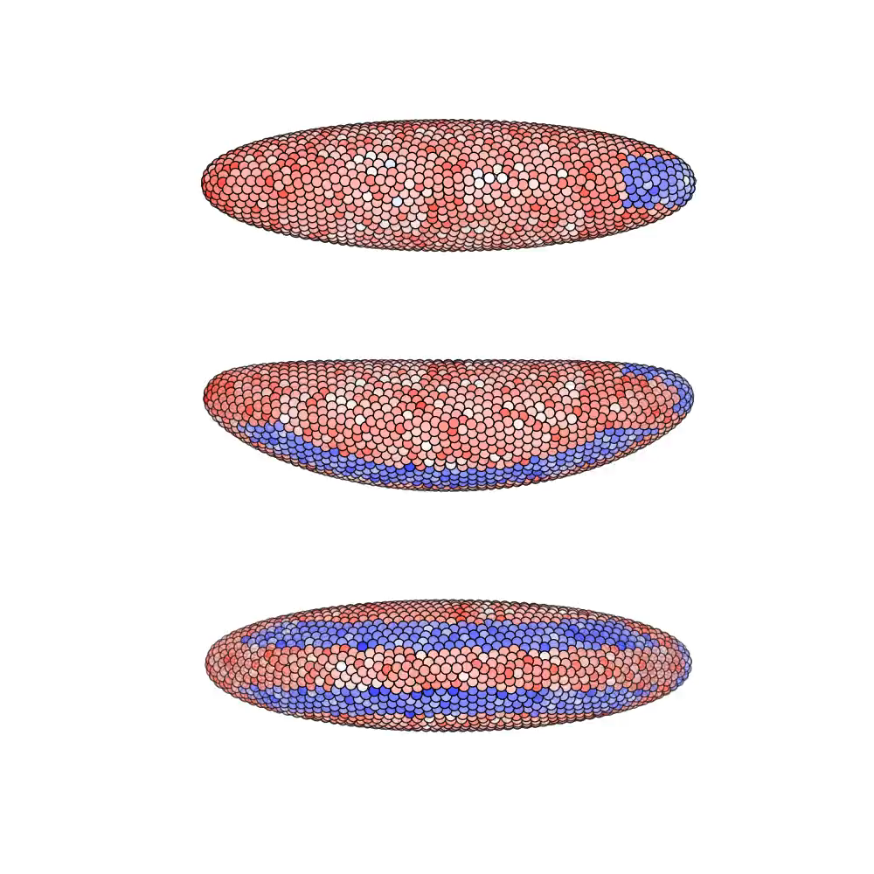
The beauty of having a simulation

Slide 18
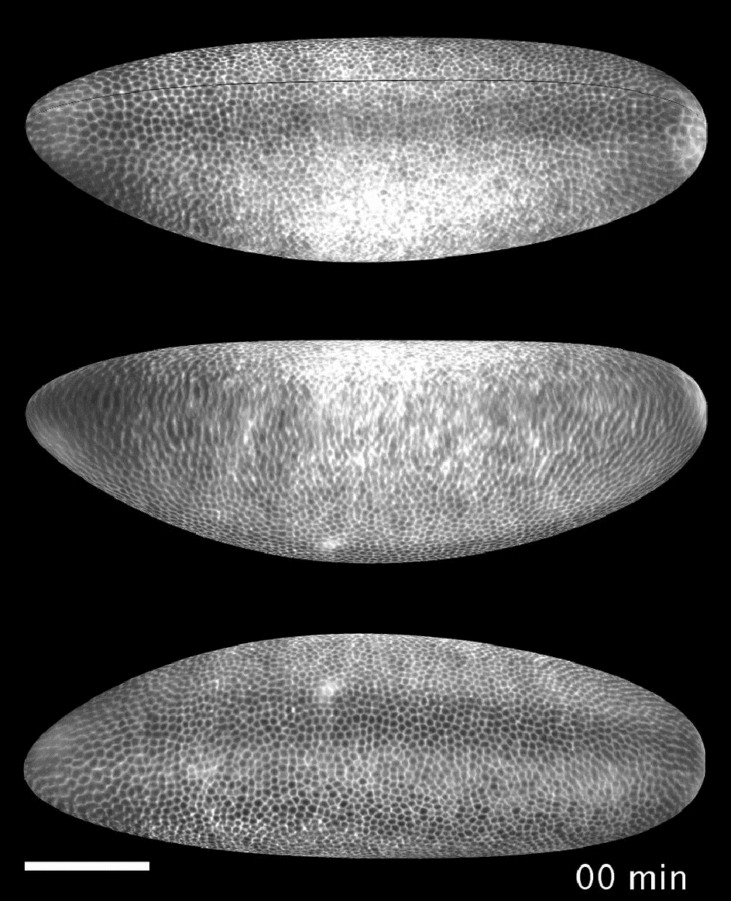
What I will be doing for the coming year
Simulating mutants
Something else?

Slide 19
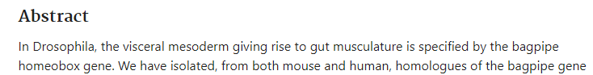
Final pop quiz

